Slide 1
Introduction
Legal workflows

Slide 2
Legal Analytics Workflows
Input: Collection of 100s of judgements, scarped from websites
Extraction of Title, Names of Appellant-Respondents-Judges, important keywords-theme, Core of the judgement, Summary etc.
Workflows:
Searching for topic: Judgments related to “Worker’s disputes”, “Divorces”, etc.
Finding Similar judgements by Term Frequency: Represents document as a list of most occurring words and finds “distance”. Say, Doc1 has keywords [k1, k2,….] find documents with as many keywords as that of Doc1.
Extracting Summary: Finding statements, with most occurring imp words.
Advantages: Its more than just a Web-search. It presents keywords, judgements, information relevant to a topic.

Slide 3
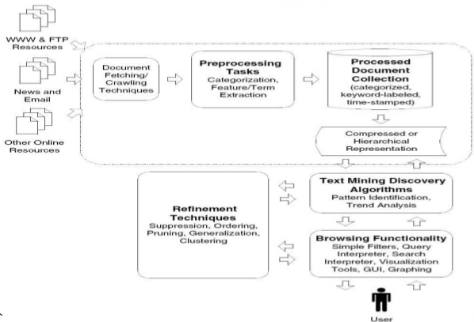
Generic NLP architecture
Text Sources
Pre-processing
Html -> Text
Db -> Text
Linguistic Pre-Processing
Tokenizing
Stop word removal
Text Algorithms
Results reporting

Slide 4
Searching
More than just string matching

Slide 5
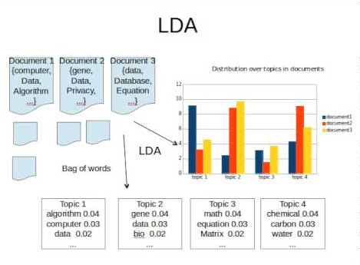
Topics by LDA (Latent Dirichlet Allocation)
Discovering hidden topical patterns that are present across the collection
Doc 1: I had a peanut butter sandwich for breakfast. Doc 2: I like to eat almonds, peanuts and walnuts. Doc 3: My neighbour got a little dog yesterday. Doc 4: Cats and dogs are mortal enemies. Doc 5: You mustn’t feed peanuts to your dog.
Topic 1: 30% peanuts, 15% almonds, 10% breakfast (food!!) Topic 2: 20% dogs, 10% cats, 5% peanuts… ( you can interpret that this topic deals with pets or animals)
Docs 1 and 2: 100% Topic 1 Docs 3 and 4: 100% Topic 2 Doc 5: 70% Topic 1, 30% Topic 2

Slide 6
Document Similarity
Fetching similar documents

Slide 7
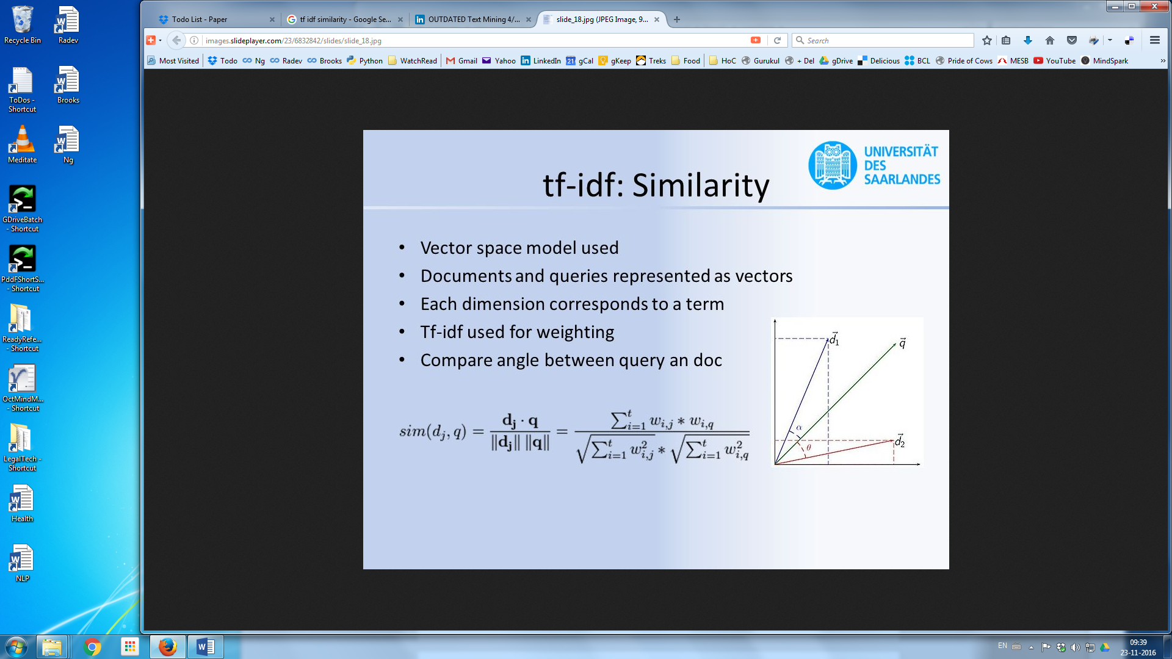
Similarity by TF-IDF and Cosine
TF-IDF (Term Frequency Inverse Document Frequency) Method
Input: Set of documents
Each document is Vectorised by TFIDF
Similarity between documents d₁ and d₂ is angle between them
If angle is 0, they are similar (exact)
If angle is 90 they are different.
Query q can also be evaluated to see if its closer to d₁ or d₂ then return the closer one.

Slide 8
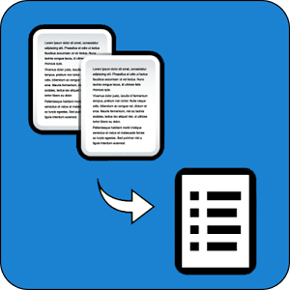
Automatic Text Summarization
Judgements to Headnotes

Slide 9
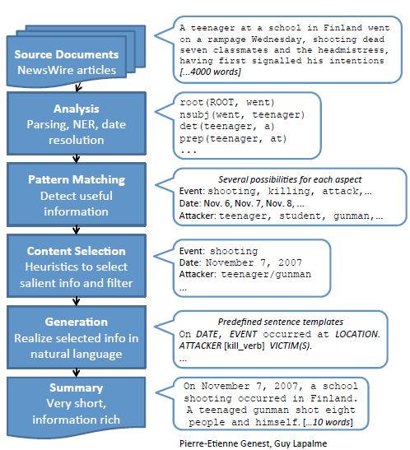
Summarization
The process of condensing a source text into a shorter version preserving its information content is called summarization.
The motivation Here is to build such tool which is computationally efficient and creates summaries automatically.
Current Applications
Multimedia news summaries
Abstracts of Research papers
Minutes of the meetings
Book reviews

Slide 10
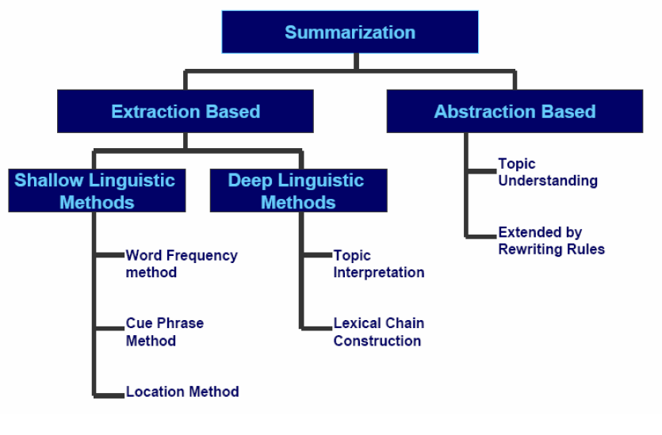
Types of Summarizations
Extraction vs. Abstraction
Extract is a selection of some of the material of the original,
Abstract is a condensation and reformulation of the original.
Informative vs. Indicative vs. Evaluative
Informative summary reflects the content of the original text
Indicative summary merely provides an indication of the original
Evaluative evaluates the subject, expressing the abstractor's views
Generic vs. Query
a Generic summary provides the author’s point of view,
Query-based summary focuses on material of interest to the user.

Slide 11
Evaluation criteria
Reduction of information content
Compression Rate, also known as condensation rate, reduction rate.
Measured by summary length / source length ( 0 < c < 100)-
Informativeness
Fidelity to Source
Relevance to User’s Interests
Well-Formedness
Syntactic and discourse-level
Need to avoid gaps, dangling anaphors, ravaged tables, lists, etc..

Slide 12
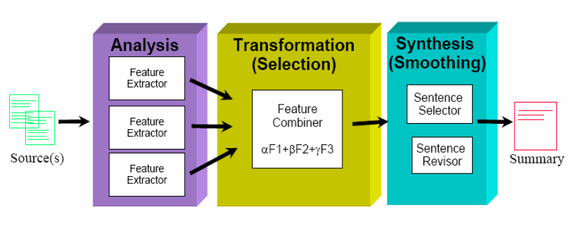
Summarization Functional Architecture

Slide 13
Technical Architecture
Reports, CRM
Legal texts are extracted from various sources such as websites, Legal databases, etc.
Stored in Legal XML
XML text is processed for various functionalities such as Search, Similarity and Summarization.
Process
Text Analytics Algorithms
Legal XML
Extract
Connect
Extract
Web
Web
Data
base
App Layer

